Slide 1


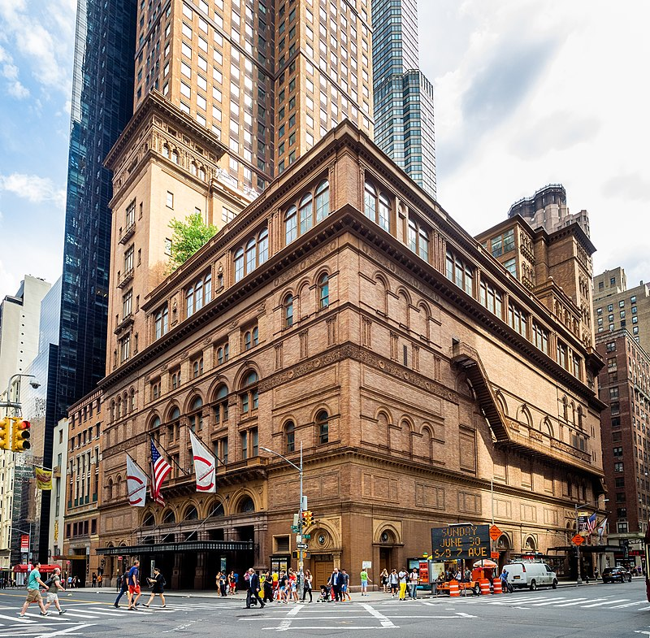
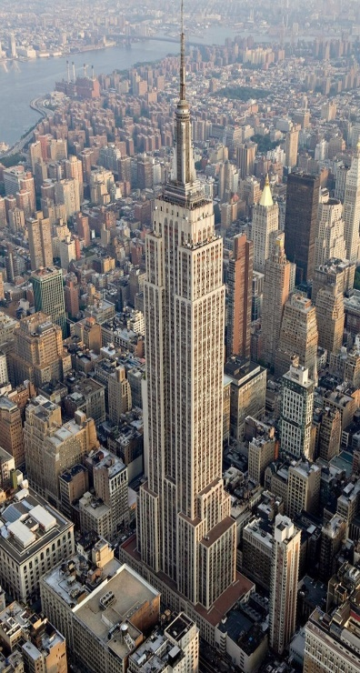
Landmarks & Airbnb Listings in new York city
Alyshia Kiczma
Arshdeep Khurana
Nasir Qadri
Kaylyn Valdez-Scott

Slide 2
Project description
We are a group hired by Airbnb, tasked with creating a dashboard of visualizations showing the locations of Airbnbs listed and the locations of historical landmarks in an interactive map format using latitudes and longitutes
We are tasked with creating visualizations of……….

Slide 3
Questions of Interest
What are the major landmarks surrounding boroughs in New York City?
Where can consumers stay when on a trip and what different housing options are available? Ex. Shared rooms, hotel, entire houses.
What are the prices of these locations to stay?
other questions based on other visualizations

Slide 4
ETL

Slide 5
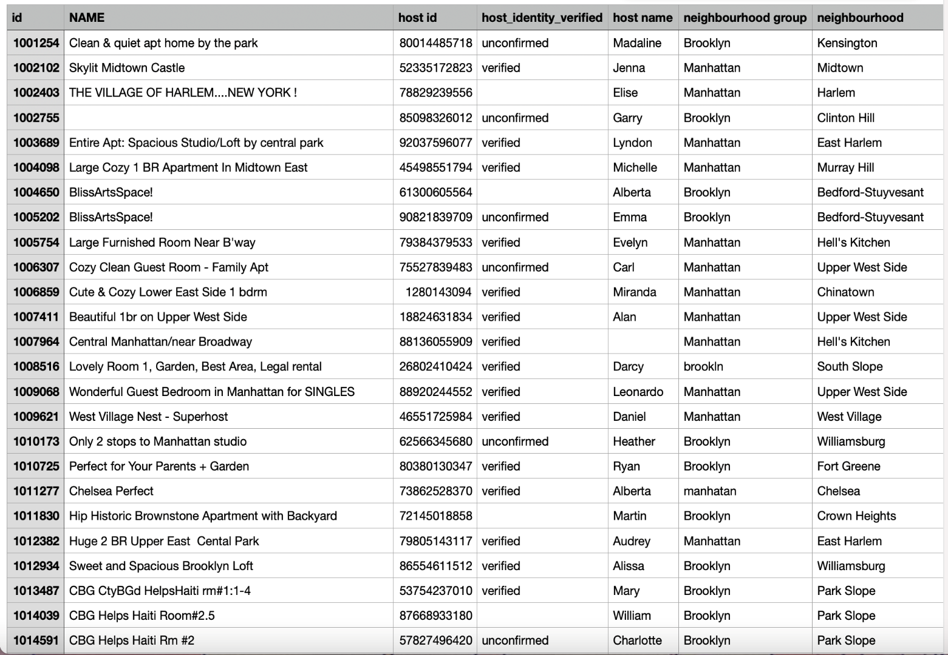
Data set (used in project 1)
https://www.kaggle.com/datasets/arianazmoudeh/airbnbopendata?select=Airbnb_Open_Data.csv

Slide 6
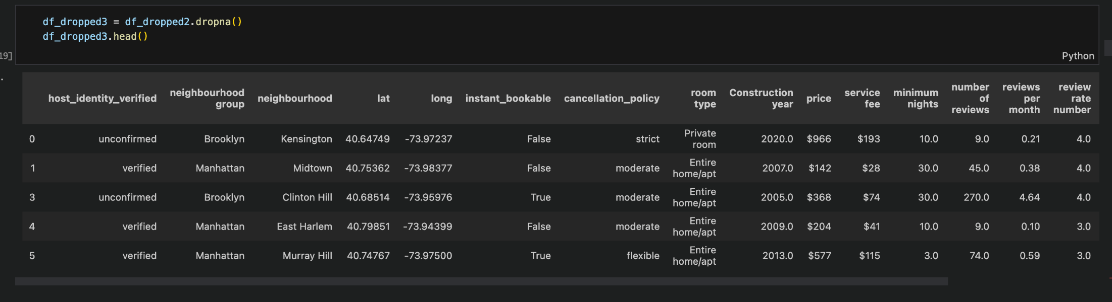

Slide 7
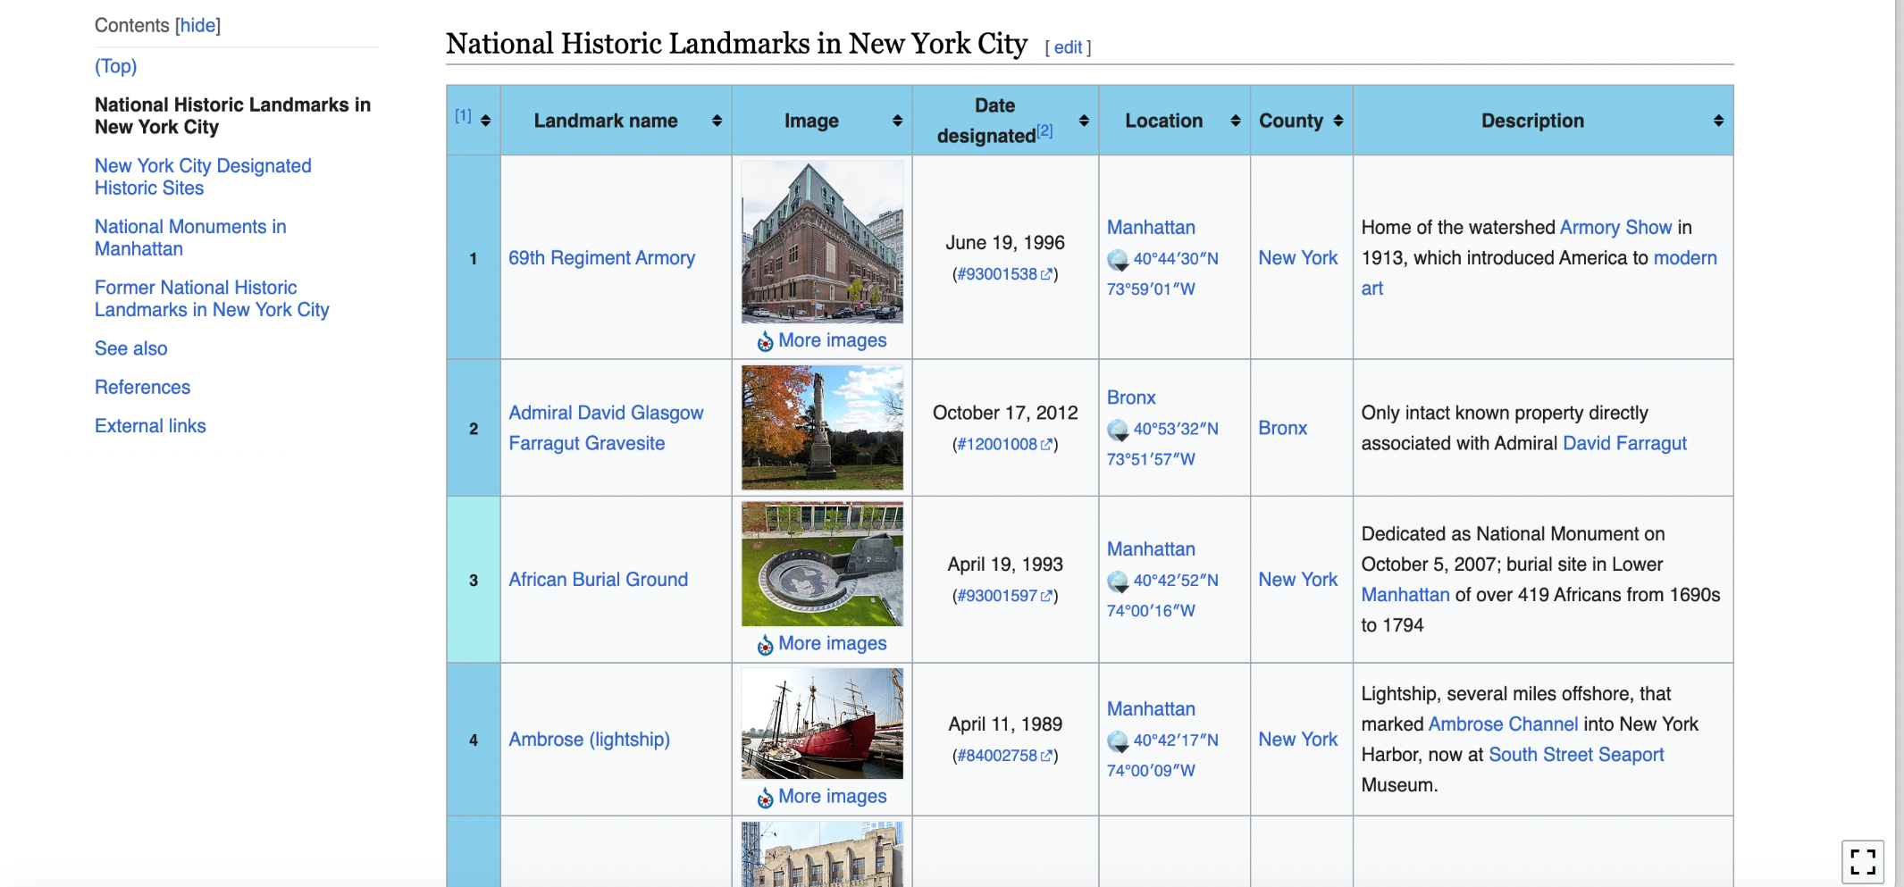
Web Scraping from Wikipedia

Slide 8
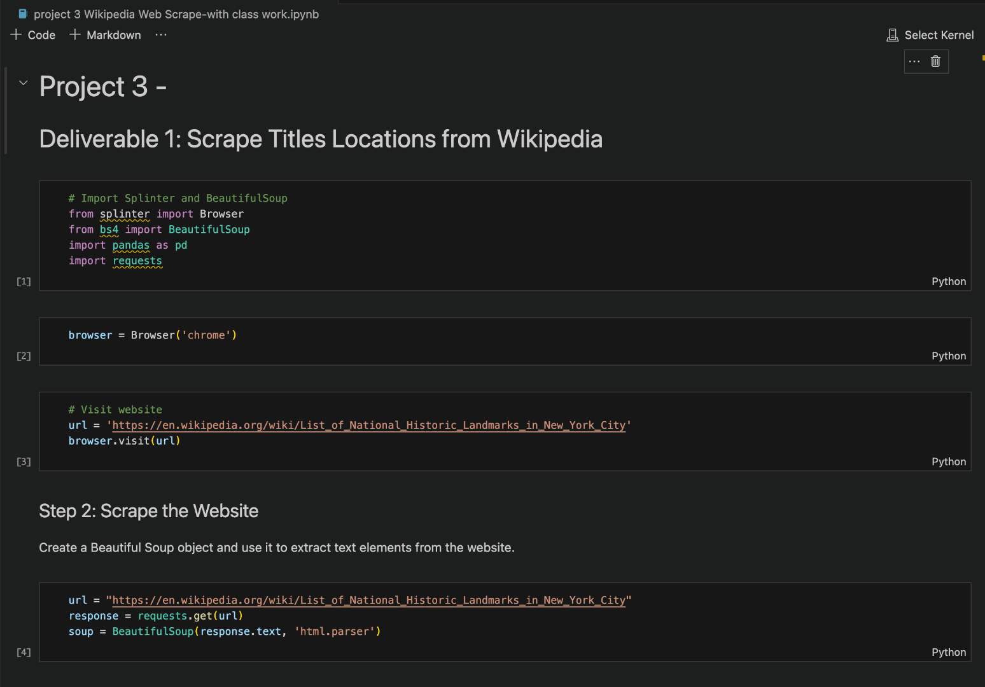
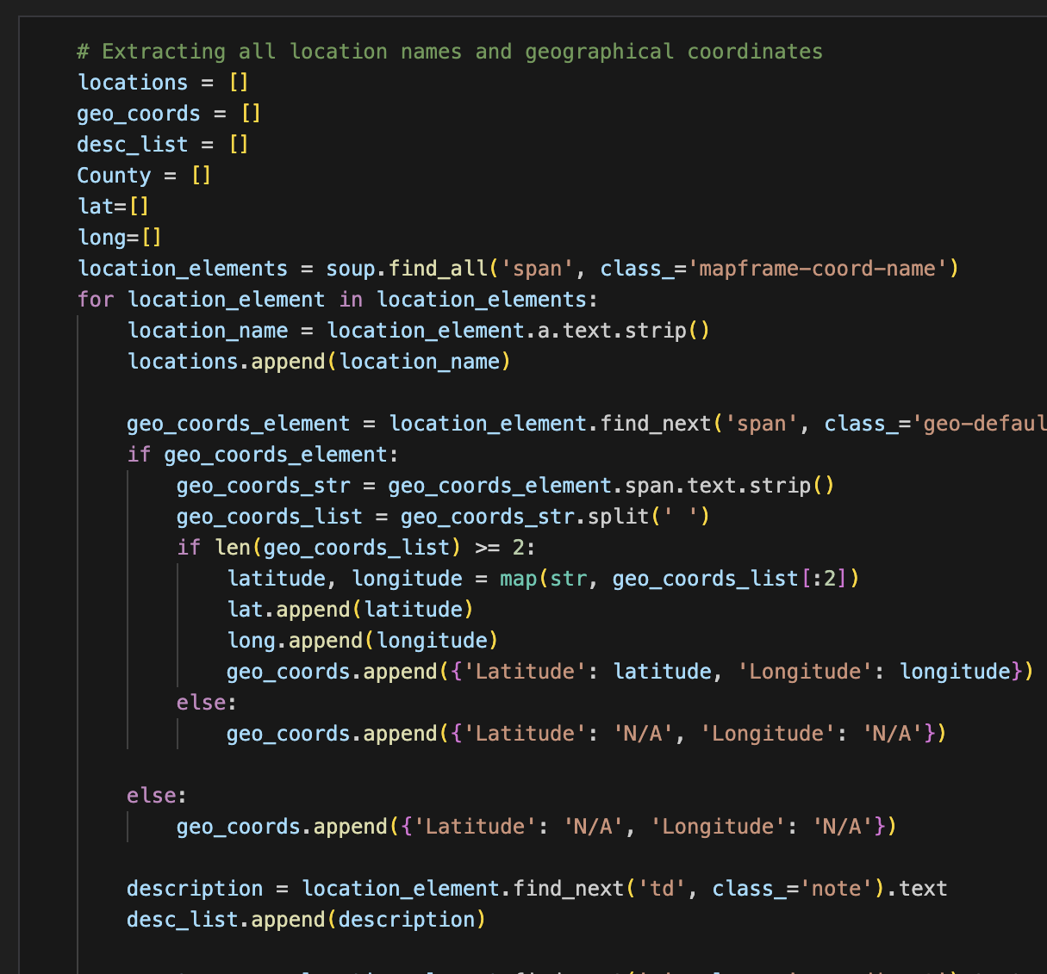

Slide 9
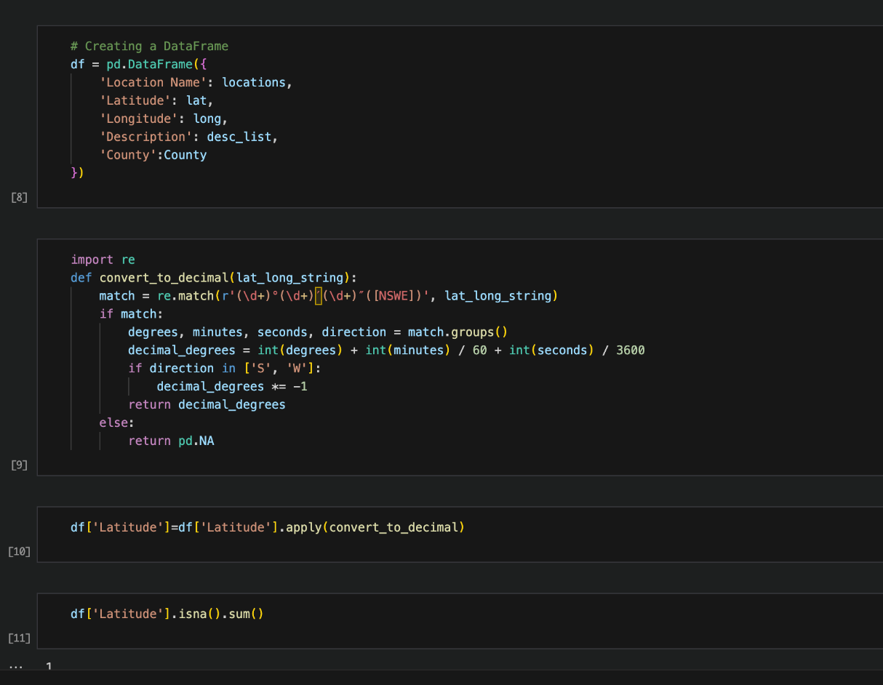
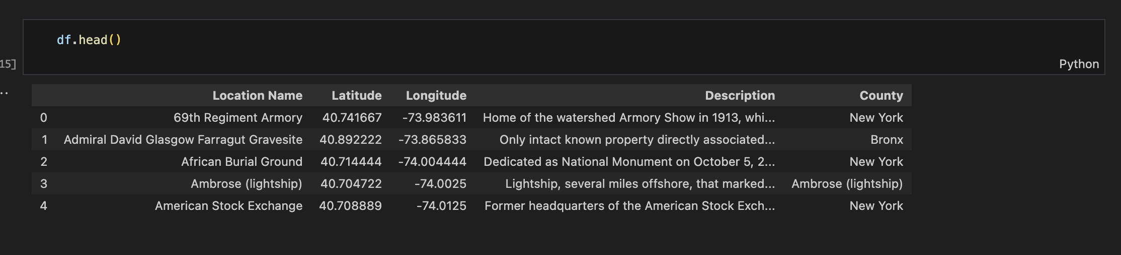
New dataframe

Slide 10
Dashboard

Slide 11
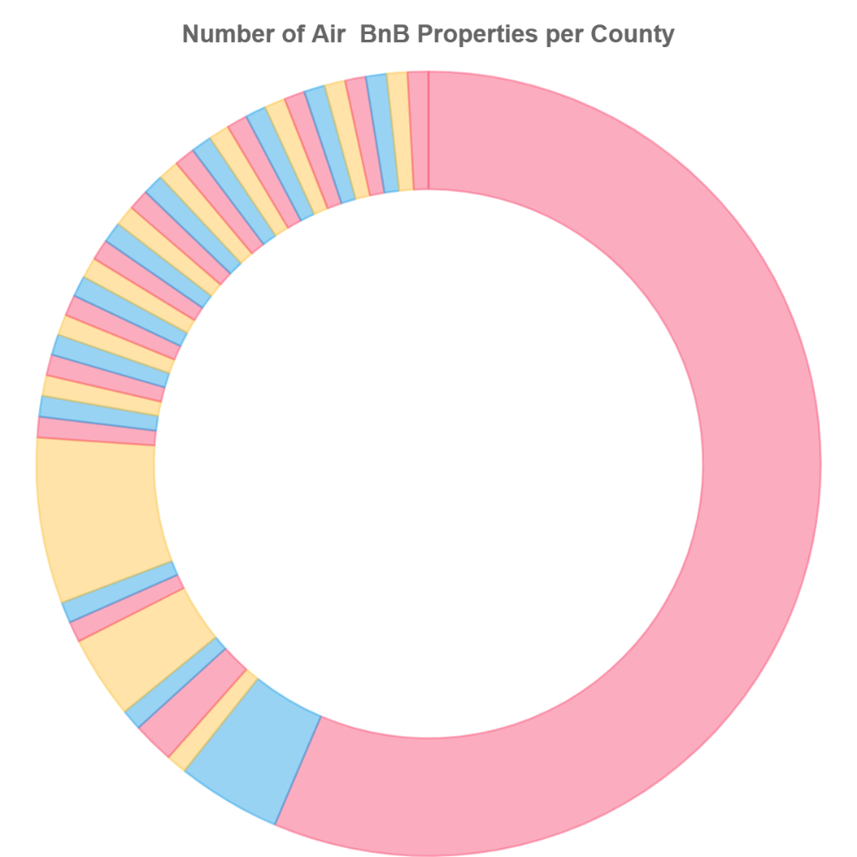
visualizations

Slide 12
map of Airbnb rental locations

Slide 13
map of nyc landmarks

Slide 14
other visualization ??

Slide 15
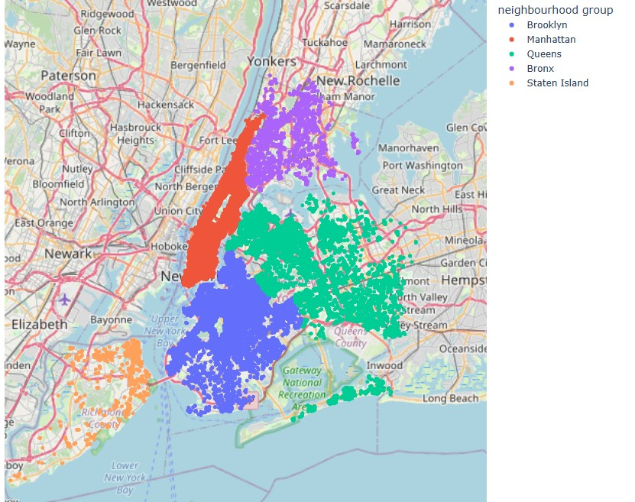
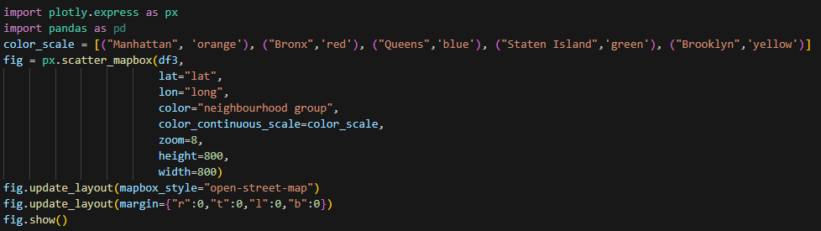
Listing volume by neighbourhood group

Slide 16
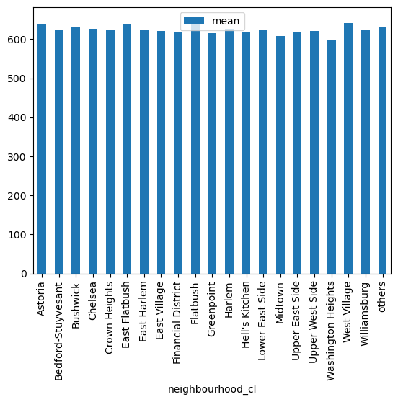
Do different neighbourhoods or neighbourhood groups differ in price?

Slide 17
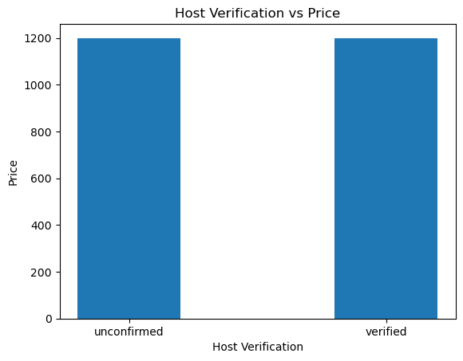
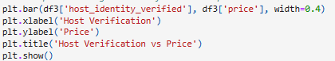
Does having a verified host impact price?

Slide 18
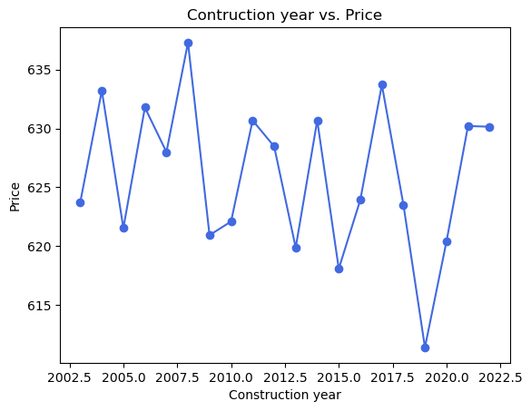
Does construction year impact price
Construction Year Median | Construction Year Variance | Construction Year Std Dev | Construction Year SEM | Construction Year Max | Construction Year Min
2012 | 34.373862 | 5.862923 | 0.121933 | 2022 | 2003
2013 | 33.145421 | 5.757206 | 0.030689 | 2022 | 2003
2012 | 32.878289 | 5.733959 | 0.03058 | 2022 | 2003
2012 | 34.023267 | 5.832947 | 0.054874 | 2022 | 2003
2011 | 34.271451 | 5.854182 | 0.202592 | 2022 | 2003
2010 | NaN | NaN | NaN | 2010 | 2010

Slide 19
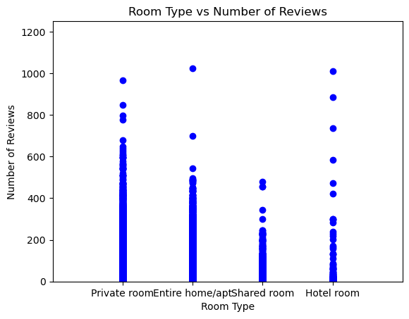
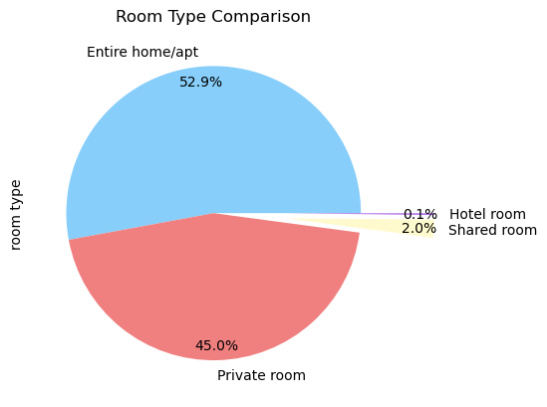
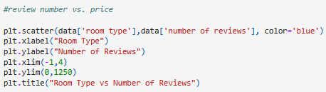
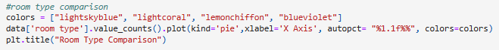
Room Type

Slide 20
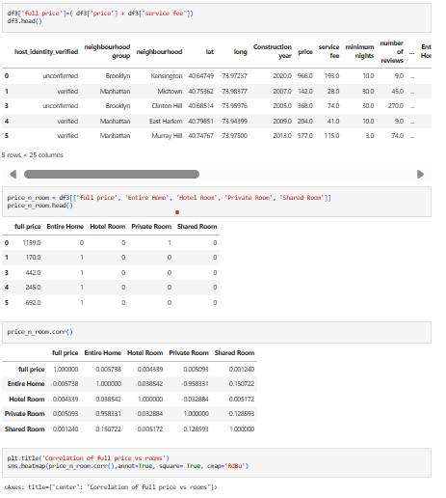
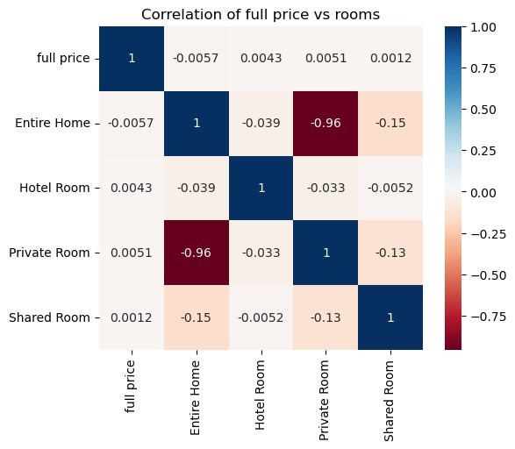
Price vs. Room type

Slide 21
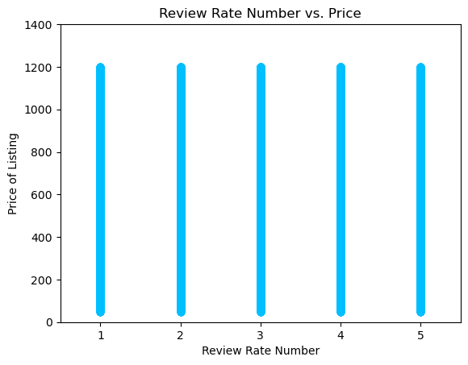
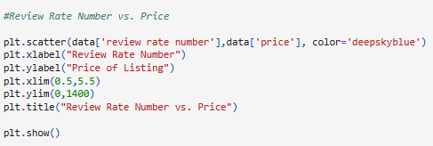
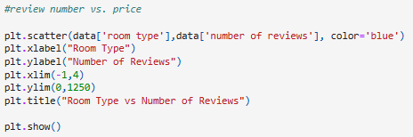
do number of reviews differ based on room type?

Slide 22
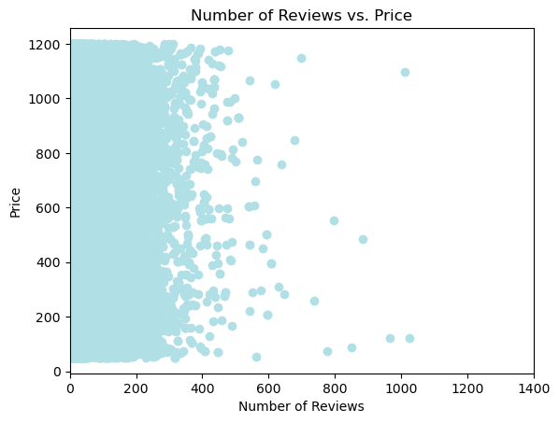
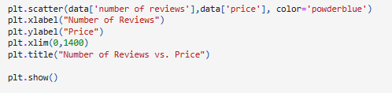
Does the review rate number impact the price?

Slide 23
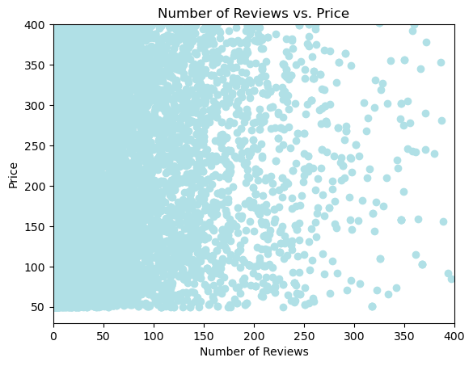
Does the review rate number impact the price?

Slide 24
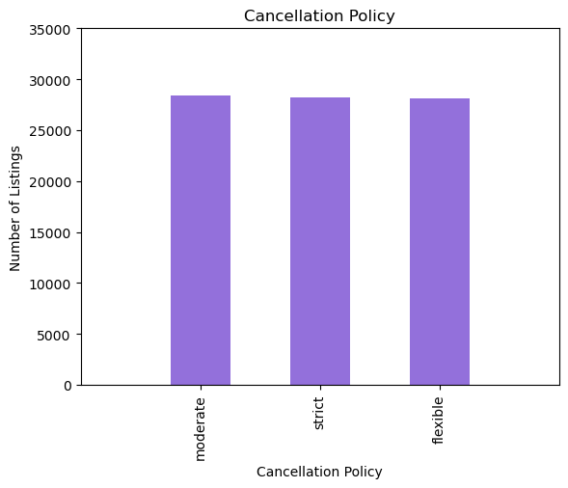
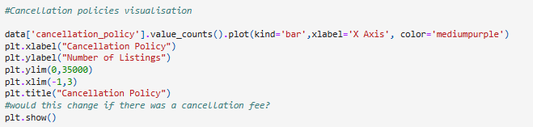
How prevalent is a cancellation policy?

Slide 25
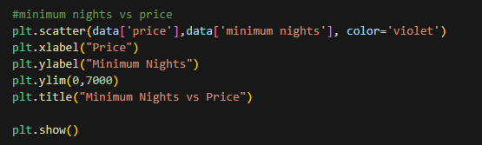
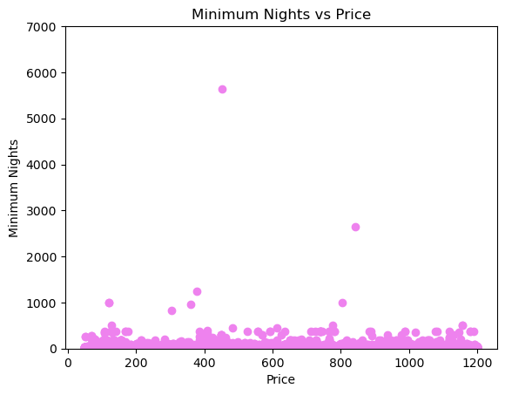
Do Minimum Nights of a Listing impact the price

Slide 26
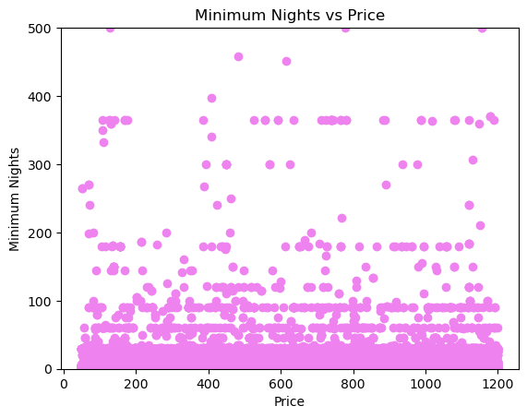
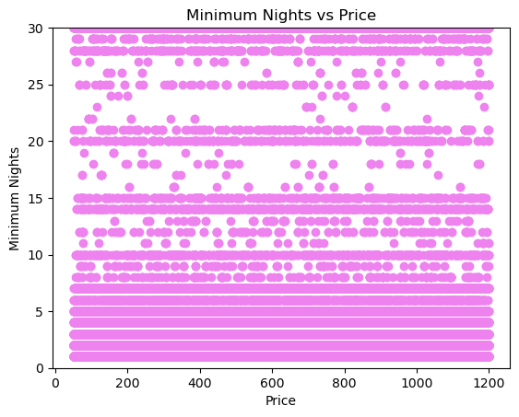
Do Minimum Nights of a Listing impact the price

Slide 27
Further investigation
do we have any

Slide 28
conclusion

Slide 29
Thank you for listening!

